Slide 1








LEVERAGING SEMANTIC ANALYSIS FOR EFFECTIVE PROFANITY FILTERING
Presented By :-
Salish Kumar (R11970947)
Nameera Khan(R11965493)
Namra Khan(R11965577)

Slide 2
What is profanity filter and why do we need it??
Our profanity filter is an advanced tool specifically designed to detect, offensive or inappropriate language in real-time text communication. By effectively filtering out abusive, offensive, or inappropriate words and phrases, this tool promotes respectful, inclusive, and safe communication spaces across social media platforms and chat applications.
our profanity filter mainly focuses on text forms of communication that are commonly implemented in social media platforms.
need:-
It blocks offensive language, useful in creating a safer, respectful, and user-friendly environment, protecting users from harassment and brands from reputational damage across digital platform.

Slide 3


Use Cases:-
kids website (for eg: stone soup)
online gaming platforms
E-Commerce Reviews and Ratings
Public Comment Moderation(for eg. Wikipedia)
Customer Support and Feedback Systems

Slide 4

Existing Approach | Solution that we propsed
With the enhancements of existing approaches, the work of profanity detection has been done in various languages across the world, including English, Chinese, Spanish, French, Japanese, Portuguese, and Vietnamese. | Our proposed idea mainly focuses on the English language, with a strong vocabulary and encoded language.
In the existing model for profanity detection, regex is used for English language analysis. This approach is effective for basic filtering due to its simplicity and speed. | In our proposed solution, we used regex and a deep learning model (BERT). We employed regex for basic filtering due to its simplicity and fast execution time. Furthermore, we trained the BERT model to detect data that was not identified accurately by the regex.
However, this approach struggles with detecting sentiment-based, encoded, or indirect profanity, as regex primarily focuses on matching explicit words rather than understanding context or underlying meaning in the text. | As a result, we successfully identified encoded and indirect profane content, ensuring comprehensive detection across a wider range of offensive language.

Slide 5

Approaches to Profanity Detection
Dataset :- In our project, we utilized three datasets—one sourced from GitHub with 1,700 observations, and the other two from Kaggle, collectively containing 180,000 rows.
regex-based was trained on the 1,700-row dataset, while the BERT deep learning model was trained on the larger Kaggle datasets to enhance its ability to detect more complex offensive contexts.
Regex_dataset:-
(dataset_1 columns :text, canonical_form_1, canonical_form_2, canonical_form_3, category_1,category_2, category_3, severity_rating, severity_description(1598 rows))
+
self generated data(60 unique values)
=
(final_regex_datset used columns: text, canonical_form_1, canonical_form_2, canonical_form_3)
Bert_dataset:-
(dataset -2 Columns: Text, IsToxic, IsAbusive, IsThreat, sProvocative, IsObscene, IsHatespeech, IsRacist(997 unique values))
+
(dataset -3 Columns: text, is_offensive(184240 values))
=
final_bert_dataset Columns: Text, IsOffenisve.

Slide 6
Approaches to Profanity Detection
Text processing techniques were applied for basic data filtration, followed by the use of BERT to handle more complex data. Moreover, we developed A fast API for the model, which was then integrated with the frontend to deliver an intuitive user demo experience.
Text Preprocessing:-
Symbol Mapping: Maps symbols (e.g., '@', '7', '!') to corresponding letters (e.g., 'a', 'T', 'i') to handle obfuscated profanity.
Normalized Symbols: Converts special characters in words to their mapped letters using the SYMBOL_MAPPING dictionary for better detection of masked profanity. Reduces repeated characters in words (e.g., "mooooron" → "moron") to handle intentional obfuscation through character repetition.

Slide 7
Approaches to Profanity Detection
Contains Profanity Regex:Processes the text with preprocessing functions and checks each word against a regex pattern to detect explicit profanity. It’s an efficient method for quickly flagging basic instances of offensive language.
BERT Model: BERT (Bidirectional Encoder Representations from Transformers) is used for more advanced detection. It helps identify context-based, indirect, or encoded profanity that the regex model might miss by considering the full sentence and understanding the relationships between words in a deeper way.
API integration: later We developed a FastAPI backend for our model, which was then integrated with a Next.js frontend. This setup provided a smooth, interactive demo that clearly displayed the model’s functionality and real-time performance.

Slide 8

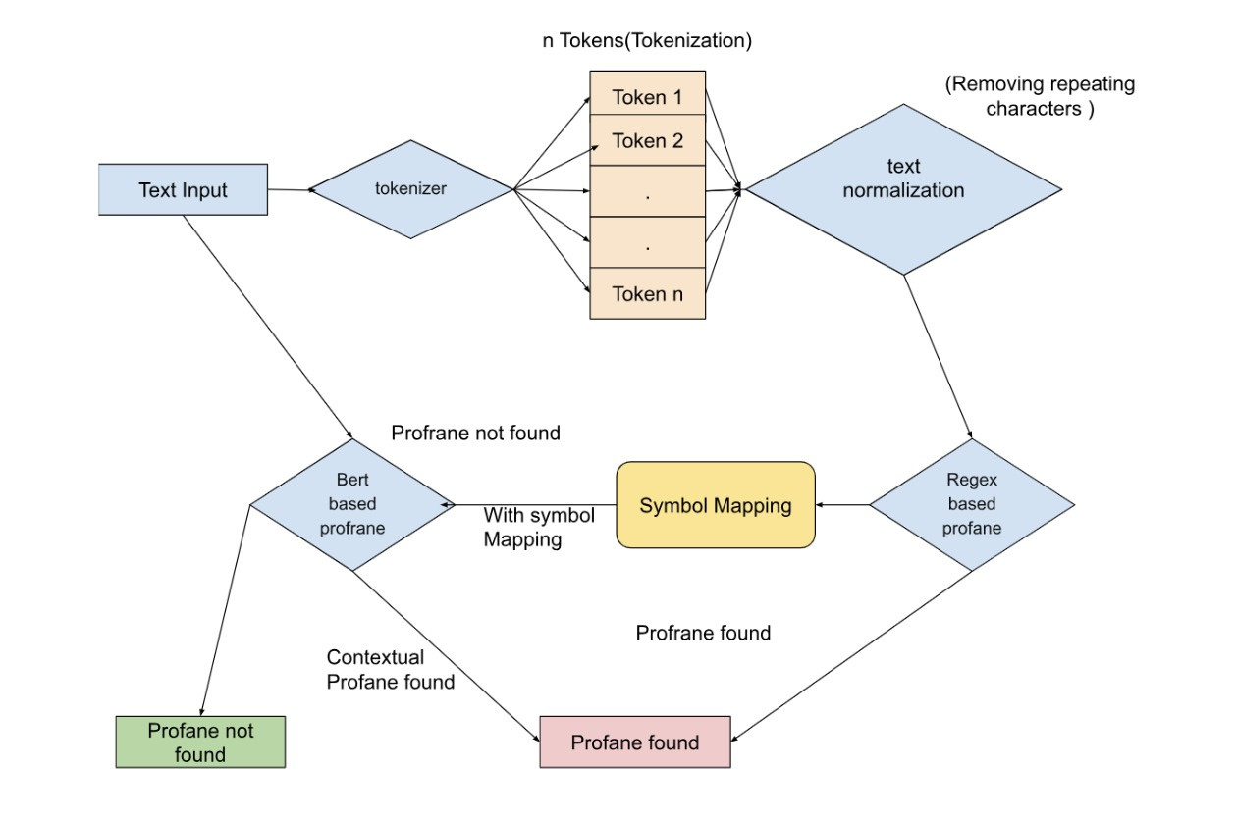

Model Architecture :-
Fig-1: Architecture of profanity Filter(Regex +BERT)

Slide 9
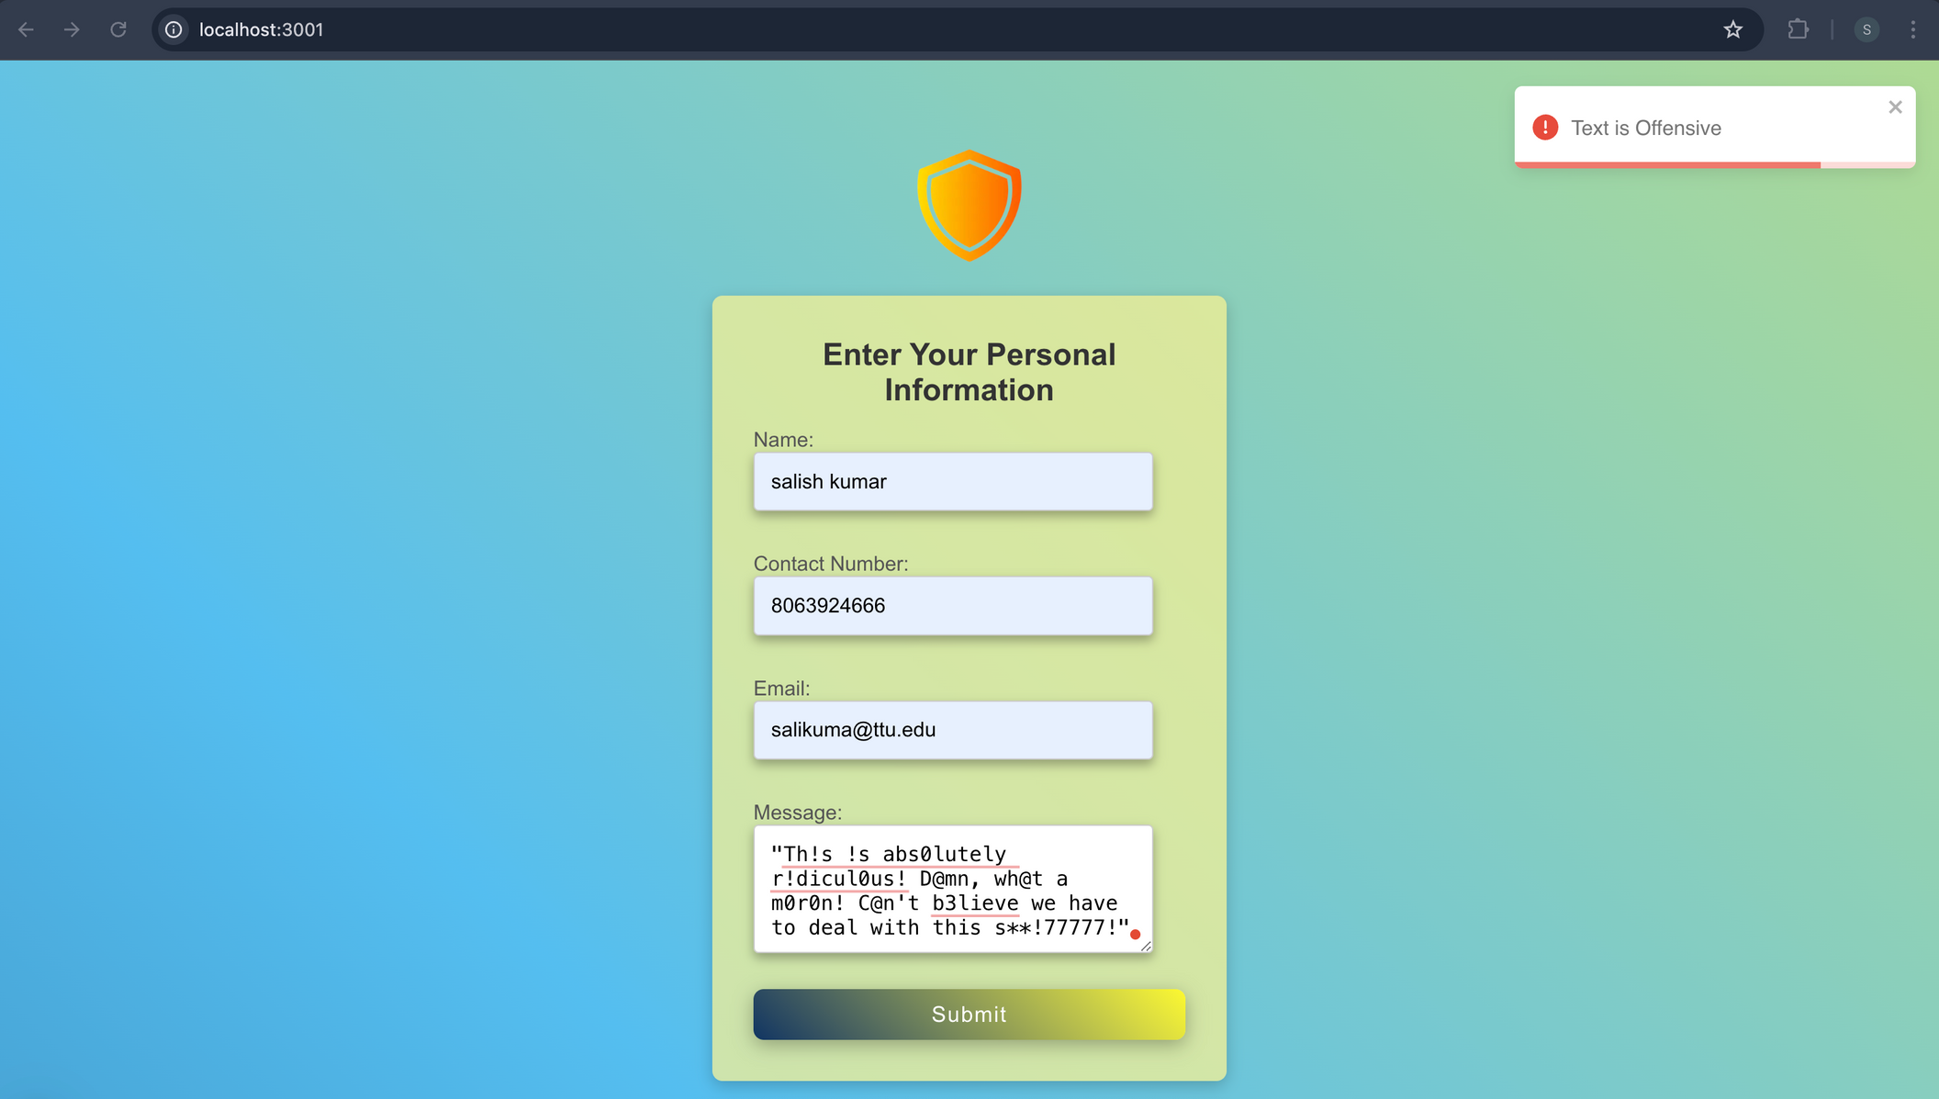
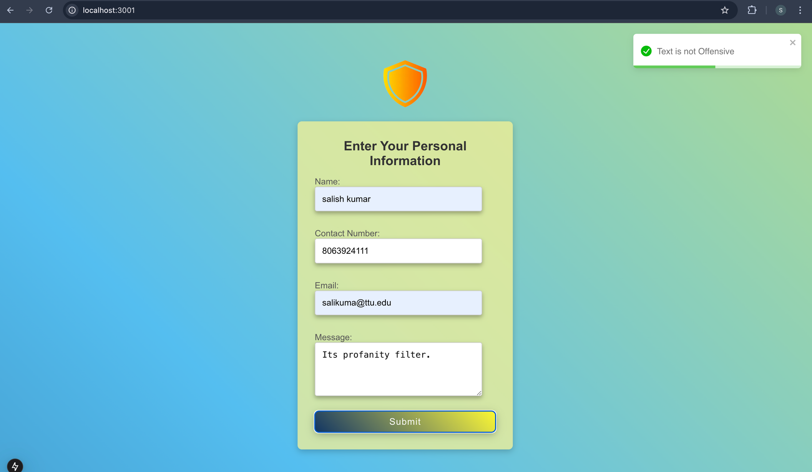
Model Results Visualization: User Interface Integration with API
Fig-2: Offensive text detected by the model
Fig-3: non Offensive text detected by the model

Slide 10



Challenges in Detecting Profanity
We tackled two major challenges in this project and achieved remarkable accuracy with both the Regex and the BERT model.
Detecting Implicit and Coded Language: This involves identifying offensive or harmful language that is not directly explicit but encoded or implied through context, wordplay, or indirect expressions.(Example: "Mind your bl00dyy G0d@*n buss!ness". The model detects the underlying insult despite the modifications, recognizing the intent behind the coded language.)
Managing Variations in Offensive Language: This involves handling misspellings, abbreviations, slang, and synonyms, ensuring the system can recognize offensive content even when altered. (Example: Variations like "s**t," "sh*t," or slang like "douchebag" are handled by normalizing different spellings or synonyms to accurately flag offensive content.)

Slide 11
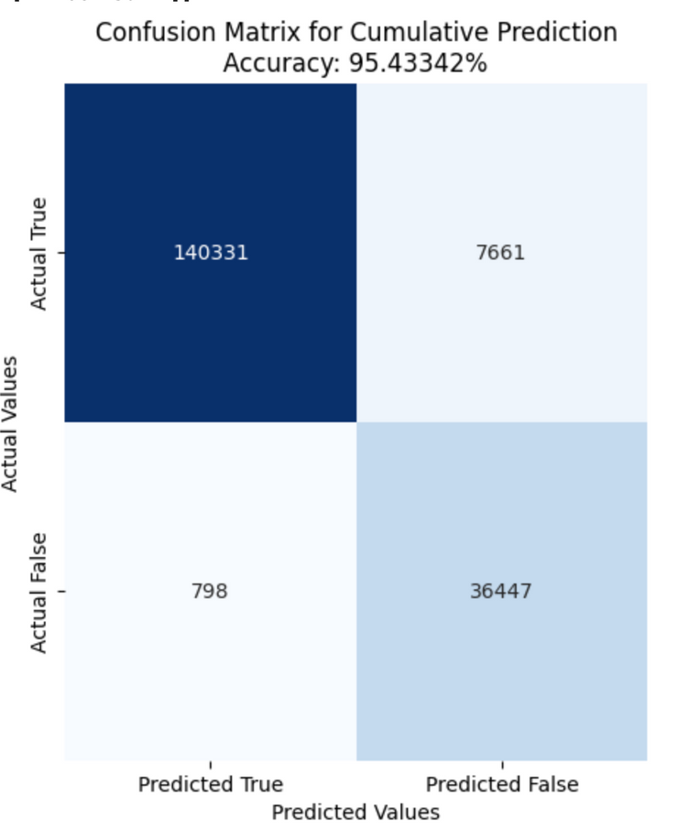

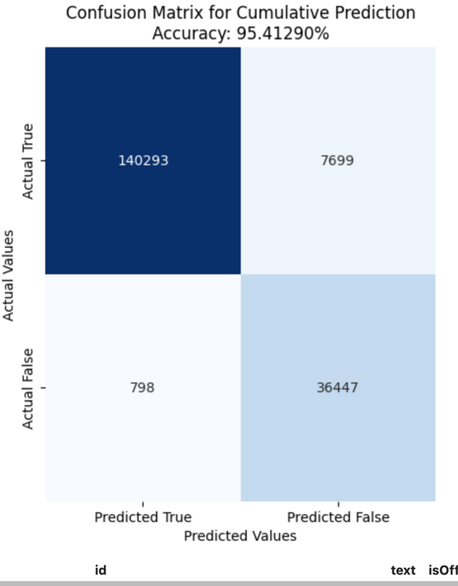


Cumulative accuracy (Regex+Bert)
Fig-4: Achieved an accuracy of 95.43% using regex_without_SM + Bert_with_SM
Fig-5: Achieved an accuracy of 95.42% using regex_without_SM + Bert_without_SM
Fig-6: Achieved an accuracy of 95.41% using regex_with_SM + Bert_with_SM
Fig-7: Achieved an accuracy of 95.40% using regex_with_SM + Bert_without_SM

Slide 12
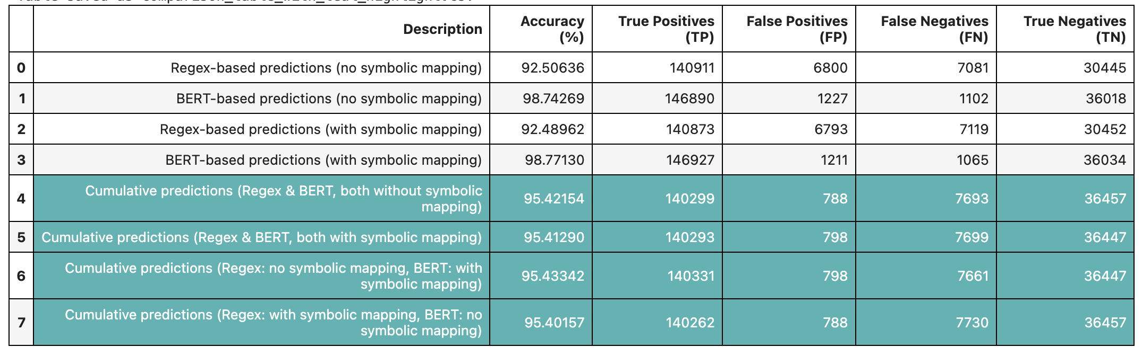
Comparison of prediction accuracies

Slide 13
Future Enhancemenets:
Detecting Sarcasm: Sarcasm often hides offensive content. By training the model to understand tone and irony, we can capture subtle, indirect forms of harm in communication.(eg. your breath smells as good as the aroma of garlic.)
Multilingual Support: Language varies across cultures, and so does offensive language. By extending support for multiple languages, the model can detect harmful content globally, ensuring broader coverage.
User Feedback Integration: Incorporating user feedback allows the model to adapt and improve over time, helping it stay updated with evolving language trends and ensuring accurate detection of all forms of offensive content.

Slide 14
DEMO...

Slide 15
THANK YOU!!!

